Slide 1
Feeling Sounds, Hearing Sights
B0344210 呂黃嘉
B0344103 曾柏嘉
B0344229 林哲

Slide 2
How many blind people in the world now?
An estimated 253 million people live with vision impairment
36 million are blind and 217 million have moderate to severe vision impairment

Slide 3
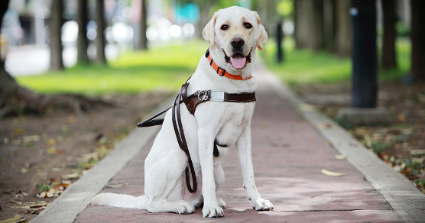
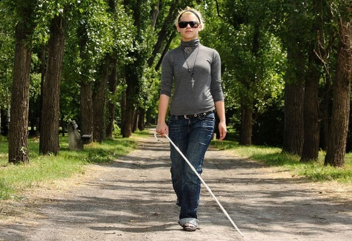
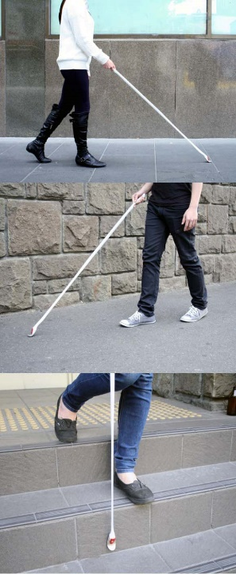
Problem
What can make our life more convenient?
Still need guide dog?
Or need crutches to help?

Slide 4

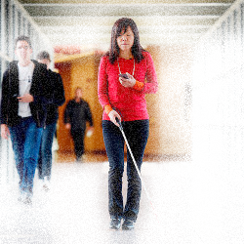

Because we have more advanced technology to help us now!

Slide 5

Introduce the product
NavCog
App Smart Phone System

Slide 6
video
https://www.youtube.com/watch?v=f-mQIWnO3Ag
Start at 5:45 end at 7:00

Slide 9
Conclusion
aging society
Agent → User
Machine Learning

Slide 10
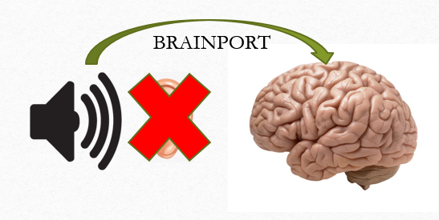
Conclusion
Feeling Sounds

Slide 11

Conclusion
Hearing Sights

